Slide 1
IBM University Engagement Project Submission
“Exploring the Power of Agentic AI with IBM Granite and IBM BOB”

Slide 2

Project Tile : AI-Powered LaTeX Diagram Generator for Academic Research
Domain of Project – [RESEARCH / ACADEMIC RESEARCH / EDUCATION]
Student Name | Recent Passport Photo | Email ID | Mobile number [WhatsApp]
LAVISHA OBEROI |  | oberoilavisha28@gmail.com | 8810674599
Recommended font style and size: Font Style: Arial Font Size (Heading): 28
Font Size (Content): 20

Slide 3
Problem Statement -
Problem Statement : AI-Powered LaTeX Diagram Generator for Academic Research
The Challenge
An intelligent agent that automatically converts natural language descriptions and sketches into professional TikZ code for LaTeX documents. It provides real-time feedback, accepts plain- English refinement commands, and delivers publication-ready diagrams while eliminating manual coding complexity for researchers.
The Objective
Build an AI-powered LaTeX Diagram Generator that turns plain-English descriptions and hand-drawn sketches into ready-to-use TikZ code. It should be able to:
Understand plain English – Describe a diagram in your own words and get back complete, working TikZ/LaTeX code.
Read sketches – Upload a hand-drawn diagram and have it turned into an accurate TikZ version.
Take feedback and refine – Ask for changes like "curve the arrows" or "add more spacing" and see them applied, no manual editing needed.
Catch and fix errors – If the code doesn't compile, it figures out what went wrong and fixes it on its own.
Show a live preview – See the diagram render as a PDF/PNG in real time while you're working on it.
Handle different diagram types – Neural networks, flowcharts, circuits, Venn diagrams, state and block diagrams, and more.
Suggest improvements – Get tips on layout and readability to make diagrams look publication-ready.
Keep track of versions – Go back to an earlier version of a diagram if needed, or compare changes over time.
Export in the format you need – Download as .tex, .pdf, or .png/.svg, ready to drop into a paper.

Slide 4
Proposed Solution -
Proposed Solution: AI-Powered LaTeX Diagram Generator
The proposed solution is an AI-powered diagram generation agent built using Flask, IBM watsonx.ai, and Granite Models to convert natural language descriptions and hand-drawn sketches into publication-ready TikZ/LaTeX code. The system addresses the steep learning curve and time cost of manually writing TikZ by automating the entire process — from idea to compiled diagram — through an intelligent, modular pipeline.
At its core, the solution uses a prompt-engineered generation layer powered by Granite models to interpret user requests and produce syntactically correct, complete TikZ code. A diagram-type detection module automatically classifies the request (neural network, flowchart, circuit, Venn diagram, state machine, etc.) and applies the appropriate styling conventions before generating code, ensuring diagrams follow academic formatting standards.
The system is organized around four core capabilities:
Generation Engine interprets natural language prompts and produces complete, compilable TikZ/LaTeX code, applying diagram-specific templates and styling rules.
Refinement Engine accepts follow-up plain-English instructions (e.g., "curve the arrows," "add color coding") and applies targeted edits to the existing diagram without requiring the user to touch code.
Compilation & Auto-Fix Engine compiles the generated code using Tectonic/TeX Live, validates it against LaTeX syntax rules, and automatically detects and corrects compilation errors, retrying until a working diagram is produced.
Sketch Interpretation Engine processes uploaded hand-drawn diagrams, extracts their structural intent, and reproduces them as clean TikZ code.

Slide 5
The solution includes a browser-based interface with a split-pane layout — a chat panel for describing and refining diagrams alongside a live preview pane showing the compiled PDF/PNG in real time. Users can browse version history to compare or revert to earlier iterations, and export finished diagrams as .tex, .pdf, or .png/.svg files ready for direct use in academic papers.
Flask orchestrates the request pipeline between the frontend, the compilation service, and the AI layer, while watsonx.ai handles scalable model access and governance for the Granite models. Granite models power the core reasoning tasks — parsing descriptions, generating TikZ syntax, diagnosing compilation errors, and suggesting layout optimizations for publication quality.
Overall, this solution delivers an end-to-end intelligent diagramming assistant that removes the technical barrier of TikZ, letting researchers focus on their ideas while the system handles code generation, error correction, and formatting.

Slide 6
Technology Used
Python Flask – For building the backend web application, handling API routes, session management, and orchestrating requests between the frontend, AI layer, and LaTeX compilation service.
IBM Granite Model – for e.g. ibm/granite-13b-instruct-v2 – For natural language understanding, TikZ code generation, error diagnosis, and refinement of diagrams based on user instructions.
IBM Cloud – Provides the infrastructure to build, deploy, and scale the Diagram Generator efficiently. IBM Cloud enables a reliable, secure, and scalable environment for hosting the application and running Granite model inference.
IBM Watson Studio – For managing the AI project workspace, model experimentation, and connecting the Granite model deployment to the application.
Tectonic / TeX Live – For compiling generated TikZ/LaTeX code into PDF output, running in a sandboxed environment to safely handle and render diagram code.
pdftoppm / dvisvgm – For converting compiled PDF diagrams into PNG/SVG formats for live browser preview and export.
HTML, CSS, JavaScript (Bootstrap) – For building the responsive, chat-based frontend interface with a live code editor, split-pane preview, and version history panel.

Slide 7
IBM component Used -
Chat Input – Interface where users enter diagram descriptions, refinement instructions, or upload hand-drawn sketches.
IBM Watsonx.ai Agent – Processes user input using Granite models to generate, refine, and debug TikZ/LaTeX diagram code.
Name of IBM Granite Model - granite-8b-code-instruct→ Used for natural language understanding, TikZ code generation, error correction, and diagram optimization suggestions.
Chat Output – Displays AI-generated responses such as generated TikZ code, explanations, error fixes, and optimization suggestions.
IBM Cloud IAM (Identity & Access Management) – Handles secure authentication and API key management for accessing Watsonx.ai services.

Slide 8
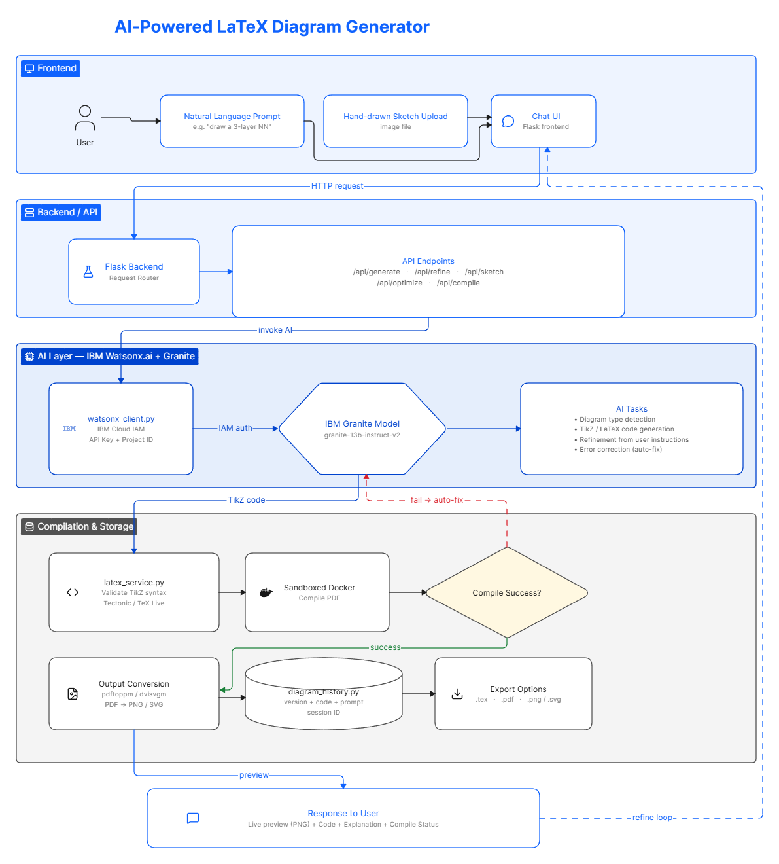
Workflow -

Slide 9
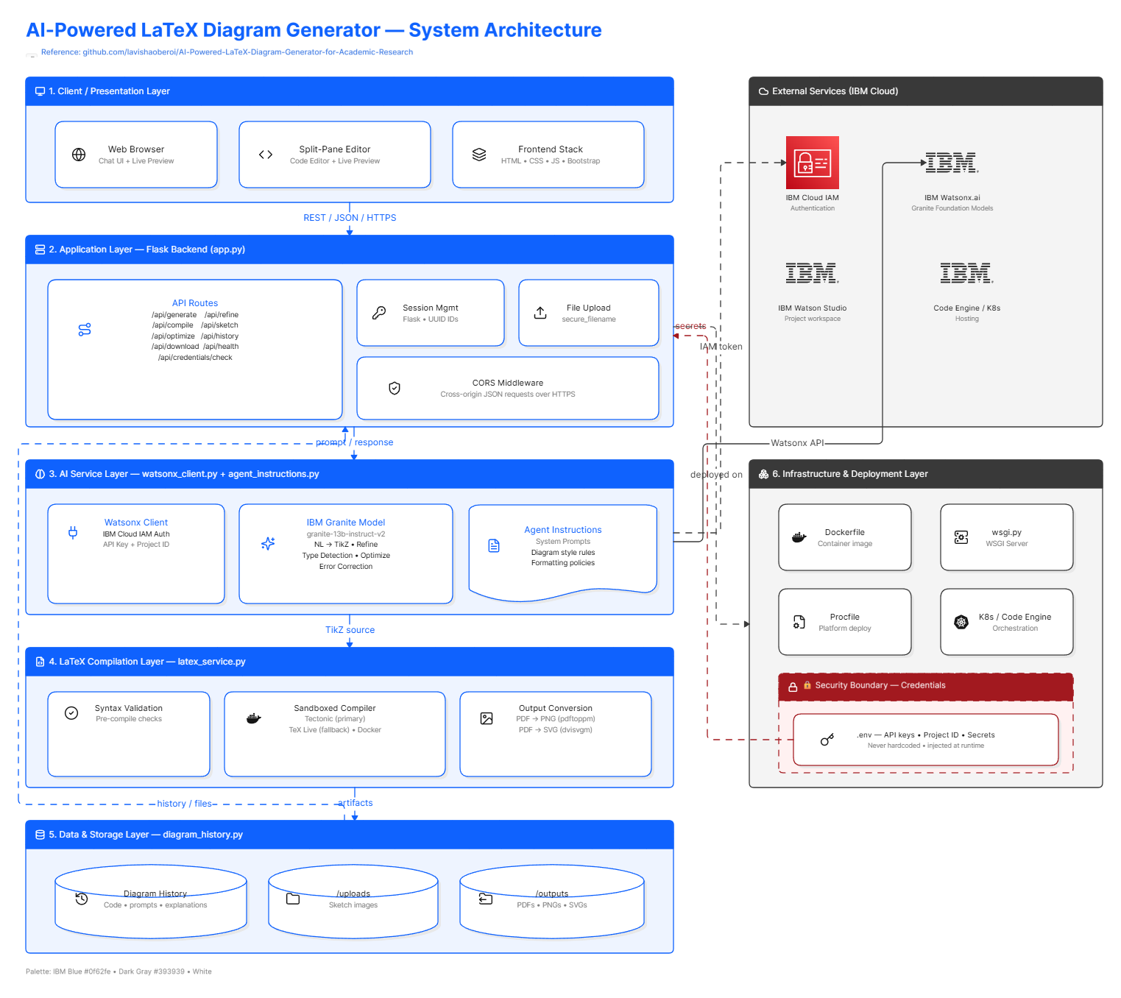
Architecture blueprint

Slide 10

Role of Agentic AI in the solution
Role of Agentic AI in AI-Powered LaTeX Diagram Generator
Agentic AI enables the LaTeX Diagram Generator to function as an intelligent, autonomous assistant rather than a simple code-generation tool. Using IBM watsonx.ai and IBM Granite models, it independently handles the full lifecycle of a diagram — from understanding intent, to generating code, to detecting and fixing its own mistakes — without requiring the user to intervene at each step.
Each part of the system performs a distinct role — interpreting natural language or sketches, generating TikZ code, validating and compiling it, and diagnosing compilation errors — while working together as a single coherent workflow. This task-driven approach ensures that a user's request moves smoothly from description to a working diagram with minimal friction.

Slide 11
Agentic AI also brings context awareness, understanding diagram type, academic formatting conventions, and prior refinement history to generate output that fits the user's actual need. It supports real-time adaptation, continuously updating the diagram as the user gives plain-English refinement instructions like "curve the arrows" or "increase node spacing."
Additionally, the system exhibits self-correcting behavior: when generated code fails to compile, it doesn't simply return an error to the user — it automatically analyzes the compiler log, identifies the likely cause, and regenerates corrected code, retrying until a working diagram is produced.
Overall, Agentic AI makes the system proactive, adaptive, and goal-driven, acting like a diligent research assistant that turns a rough idea or sketch into a clean, publication-ready diagram — handling the tedious LaTeX debugging so the researcher doesn't have to.

Slide 12
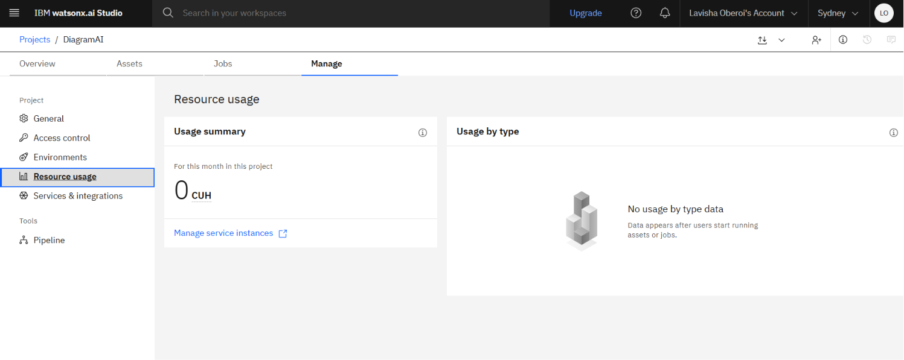
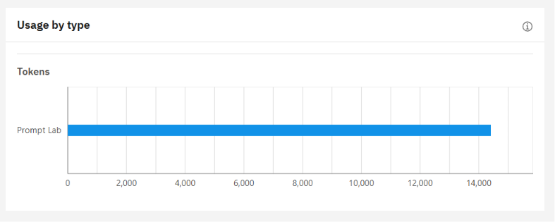
Token Usage
14,000+ tokens consumed
Before Prompt
After the Prompt
·
·
·

Slide 13
Novelty and Uniqueness
The proposed LaTeX Diagram Generator stands out by combining natural language understanding, self-correcting code generation, and academic-focused design into a single intelligent system.
Language-to-Code Intelligence – Translates plain-English descriptions directly into complete, compilable TikZ code, no syntax knowledge required.
Self-Healing Compilation – Automatically detects and fixes compilation errors instead of dumping cryptic logs on the user.
Sketch-to-Code Interpretation – Accepts hand-drawn diagrams as input, turning rough sketches into polished, publication-ready output.
Conversational Refinement – Supports plain-English edits ("curve the arrows," "add spacing") without touching code.
Diagram-Type Awareness – Auto-detects diagram category and applies the right styling and academic formatting conventions.
Real-Time Preview – Shows live compiled output as the user iterates, instead of a slow write-compile-check cycle.
Version-Controlled Iteration – Tracks diagram history for easy comparison and rollback.
Scalable & Enterprise-Ready – Built on IBM watsonx.ai with Granite models for reliable, governed AI inference.
This makes the solution a smart research companion for technical diagramming — one that understands LaTeX, fixes its own errors, and speaks the researcher's language.

Slide 14
Git Hub Link
· Please create public github repository (Enable Add README button while creating repository) with format –
Please test and Paste the working Github URL –
https://github.com/lavishaoberoi/AI-Powered-LaTeX-Diagram-Generator-for-Academic-Research.git
Make sure you have Uploaded following three files into your github repository 1) app.json file , 2) yourproblemstatement.pdf file 3) your projectpresntation.pptx file 4)any other files
·
·
·

Slide 15
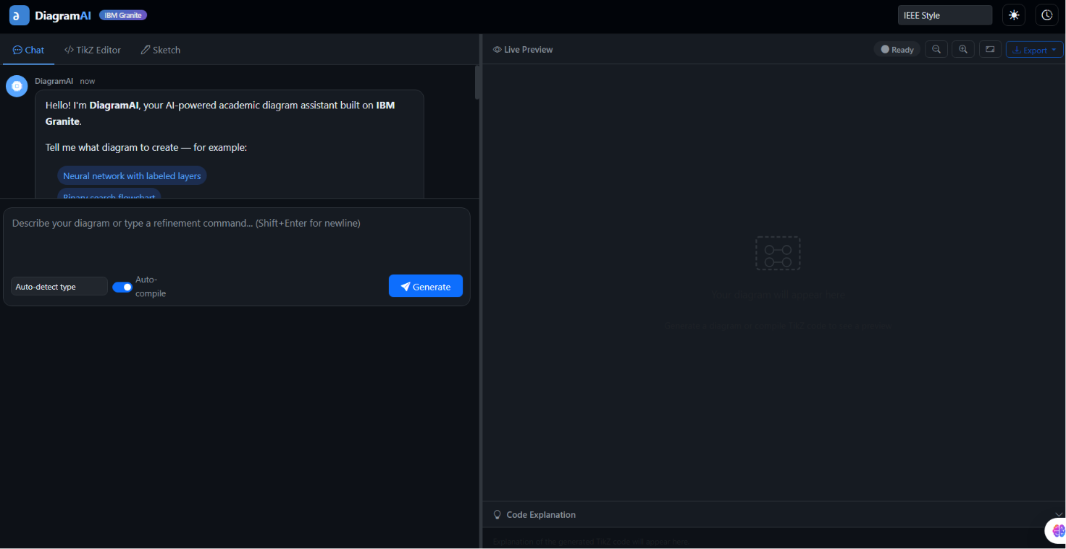

Slide 16
Future Scope
1. Overleaf & LaTeX Editor Integration – The system can be integrated as a plugin or extension for Overleaf and popular LaTeX editors (VS Code, TeXstudio), allowing researchers to generate and refine diagrams directly within their existing writing workflow instead of switching between tools.
2. Vision-Based Sketch Recognition – Upgrading the sketch interpretation module with a dedicated vision model (rather than a text-description fallback) would allow the system to directly analyze hand-drawn images — recognizing shapes, arrows, and layout — for far more accurate sketch-to-TikZ conversion.
3. Collaborative Diagram Editing – Adding real-time multi-user collaboration would let research teams co-edit diagrams together, similar to shared document editing, with live cursors and simultaneous refinement requests.
4. Journal-Specific Formatting Templates – Expanding the style profiles to auto-format diagrams according to specific journal or conference guidelines (IEEE, ACM, Springer, Nature) would save researchers additional formatting effort before submission.
·
·
·

Slide 17
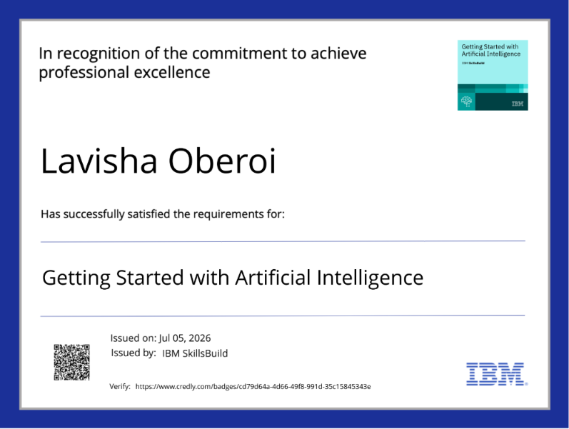
Certificates Earned:
credly certificate

Slide 18
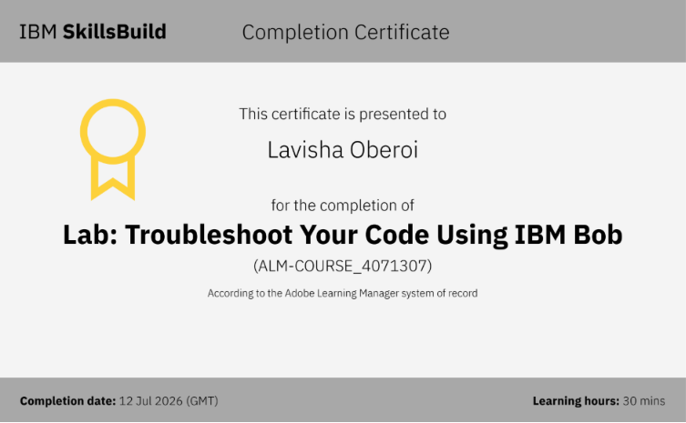
Certificates Earned:​
IBM BOB Certificate

Slide 19


